Slide 1
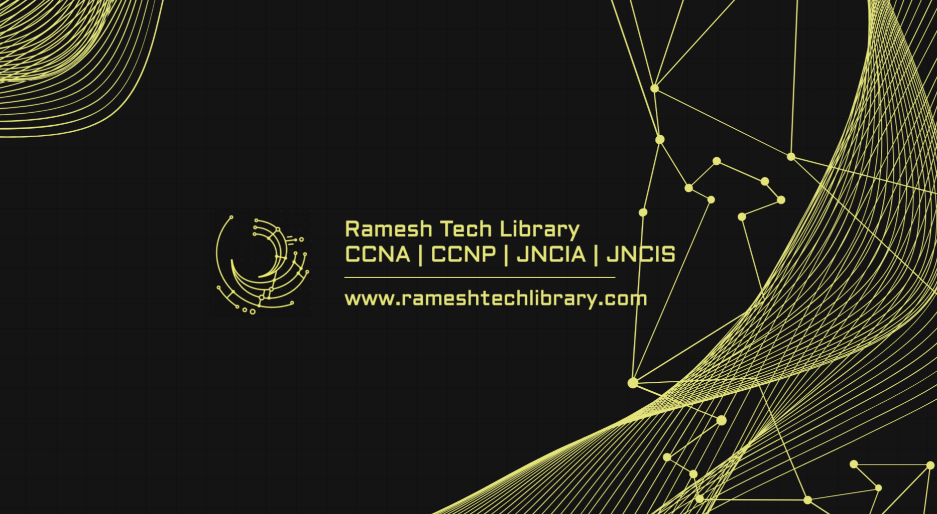

Slide 2

Topics covered in this chapter:
Data flow
OSI and TCP/IP reference Model
LAN and WAN ( Routing and Switching)
Packet Header overview
Practical verification of TCP/IP.

Slide 3
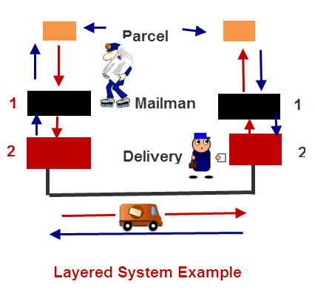
Simple courier delivery process.

Slide 4
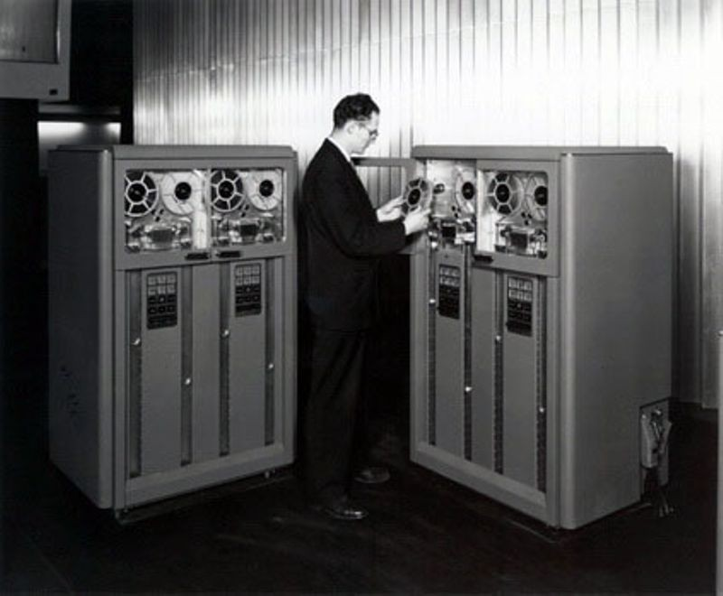

OSI (Open System Interconnection)
OSI (Open System Interconnection) model was introduced by ISO (International Standard Organization). It is not a protocol but a model which is based on the concept of layering. It has a vertical set of layers, each having different functions. It follows a bottom-up approach to transfer the data. It is robust and flexible, but not tangible.
The main intent of OSI reference model is to conduct the designing and development of the digital communication hardware, devices and software in a way that they can efficiently interoperate. Here are some important landmarks from the history of the OSI model:
In the late 1970s, the ISO conducted a program to develop general standards and methods of networking.
In 1973, an Experimental Packet Switched System in the UK identified the requirement for defining the higher-level protocols.
In the year 1983, the OSI model was initially intended to be a detailed specification of actual interfaces.
In 1984, the OSI architecture was formally adopted by ISO as an international standard.
The first successful host-to-host connection on the ARPANET was made between Stanford Research Institute (SRI) and UCLA, by SRI programmer Bill Duvall and UCLA student programmer Charley Kline, at 10:30 pm PST on 29 October 1969 (6:30 UTC on 30 October 1969).[66] Kline connected from UCLA's SDS Sigma 7 Host computer (in Boelter Hall room 3420) to the Stanford Research Institute's SDS 940 Host computer. Kline typed the command "login," but initially the SDS 940 crashed after he typed two characters.

Slide 5
TCP/IP Model
The TCP/IP Model was developed before OSI Model, and hence, the layers differ. Concerning the diagram, it is clearly seen that TCP/IP Model has four layers namely, Network Interface, Internet, Transport and Application Layer.
In 1974, Vint Cerf and Bob Kahn published a paper "A Protocol for Packet Network Interconnection" which describes the TCP/IP Model.
By 1978, testing and further development of this language led to a new suite of protocols called TCP/IP.
In 1982, it was decided that TCP/IP should be replaced NCP as the standard language of the ARPAnet.
On January 1, 1983, ARPAnet switched over to TCP/IP,
ARPAnet finished its existence in 1990. The Internet has since grown from ARPAnet's roots, and TCP/IP evolved to meet the changing requirements of the Internet.

Slide 6
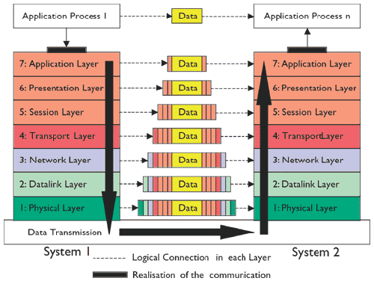
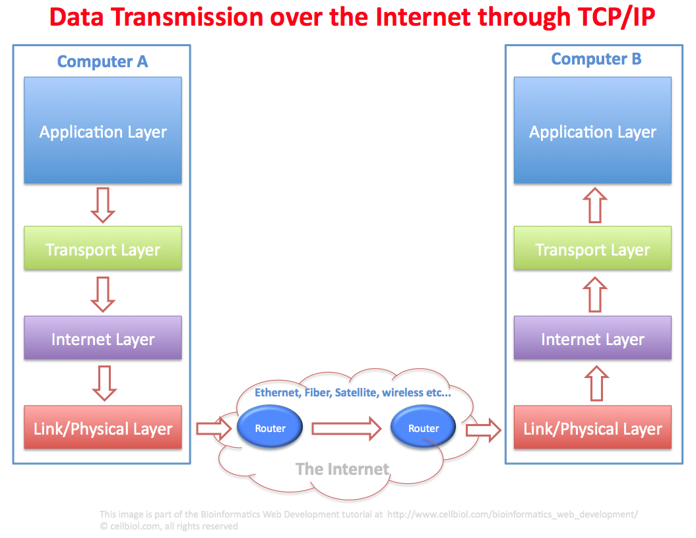

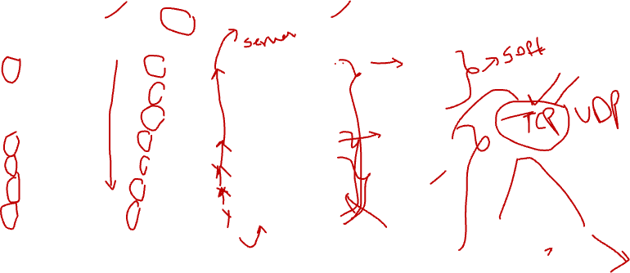
OSI & TCP/IP Reference Model

Slide 7
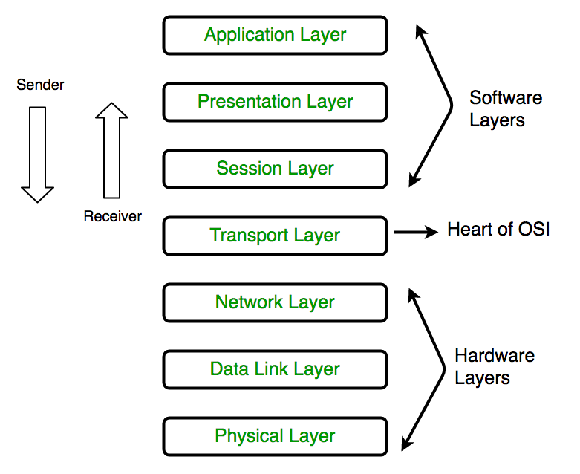
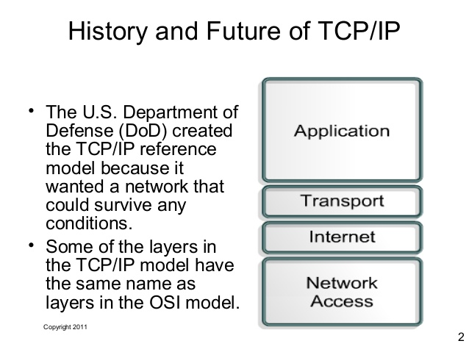

Slide 8
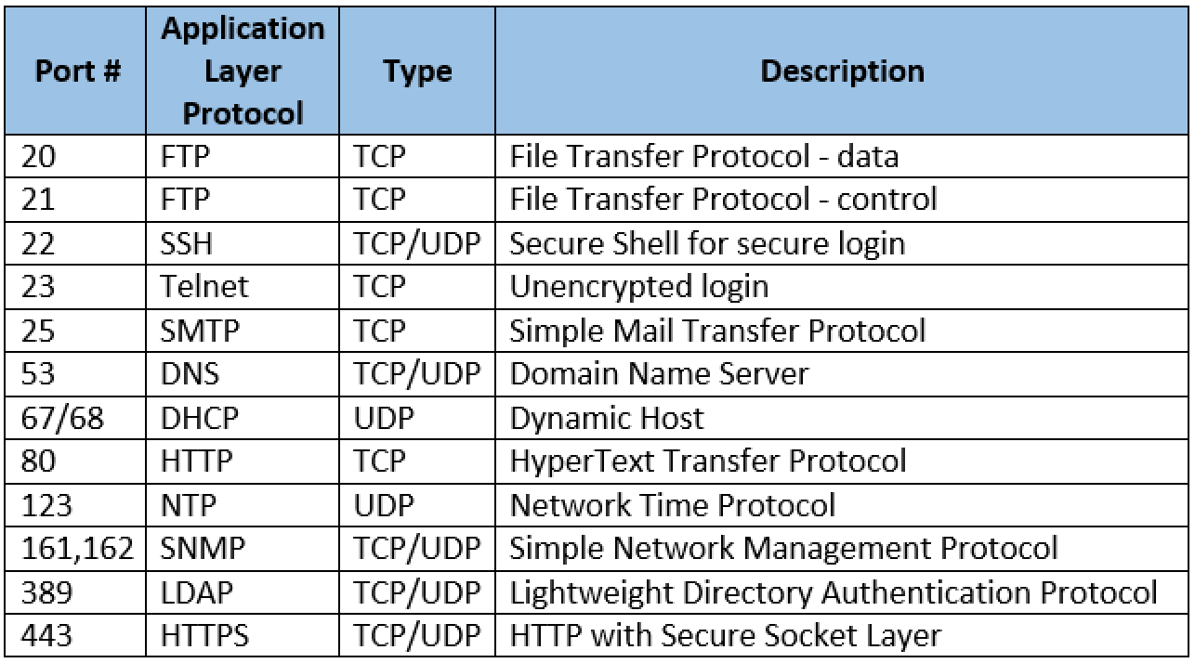
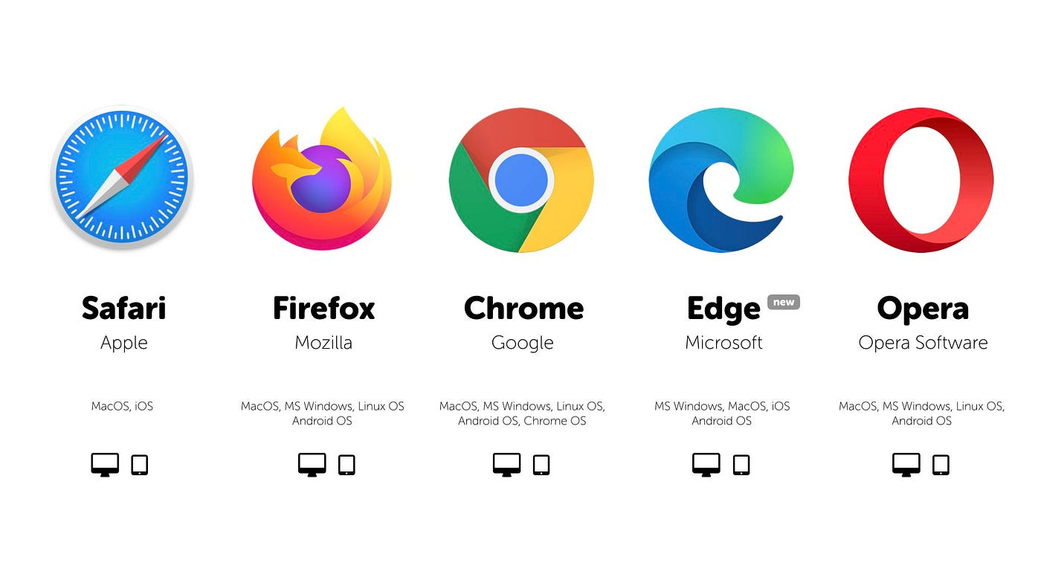
Application Layer
Application Layer: With this layer, the users can access the network by using interfaces and services like electronic mail, shared database management, file access/transfer and the other services.

Slide 9
Presentation Layer:
Presentation layer focuses on the syntax and semantics of the transmitting information. It performs tasks such as translation, encryption and compression where the actual information existing in the form of character strings, numbers, symbols is encoded into bit streams, converted into another form and compressed.
i) data – ascii. 12. 2asafdafdafdadsssasas
ii) audio – .mp3, .wav
iii) video – .avi, .mp4, .divx
iv) photo – .jpeg, .gif, .png
b) compression & decompression
c) encryption & decryption

Slide 10
Session Layer:
This layer establishes the session between different machines in order to synchronize and maintain the interaction between them. The services provided by the session layer are dialog control, token management and synchronization.
a) Create, maintain and terminate a session.
b) Mode of communication is negotiated ie. half duplex or full duplex.
c) Protocols – SQL, RPC.

Slide 11

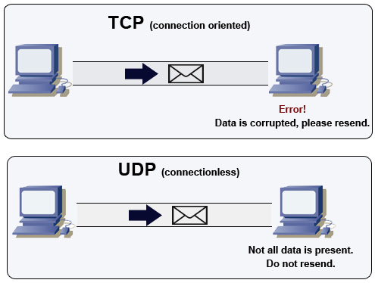
Transport Layer

Slide 12
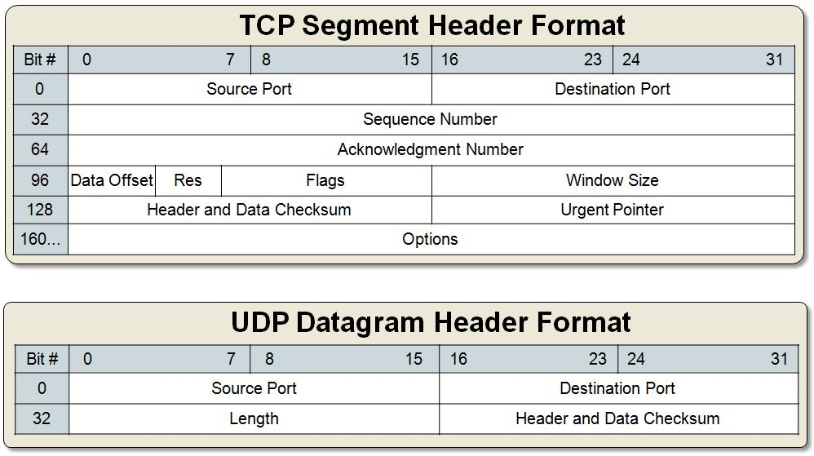

TCP and UDP

Slide 13

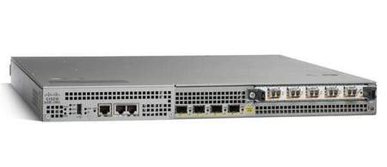
Network Layer / Internet Layer
Routers (Wide Area Network) or Routing

Slide 14
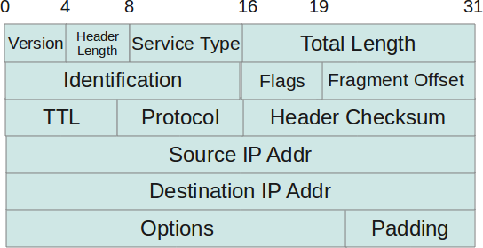
IP Header:

Slide 15
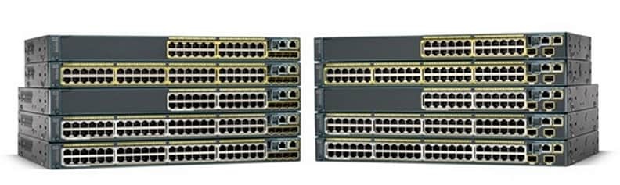
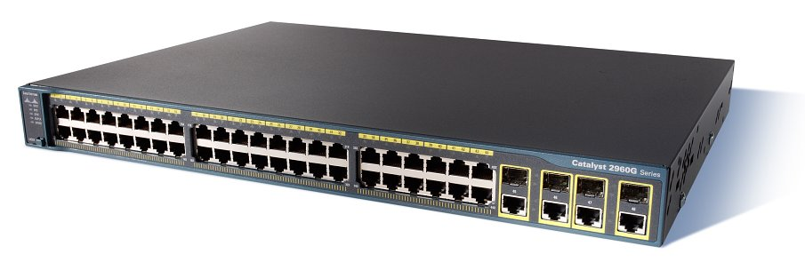
Data Link Layer
Switches (Local Area Network) or switching

Slide 16
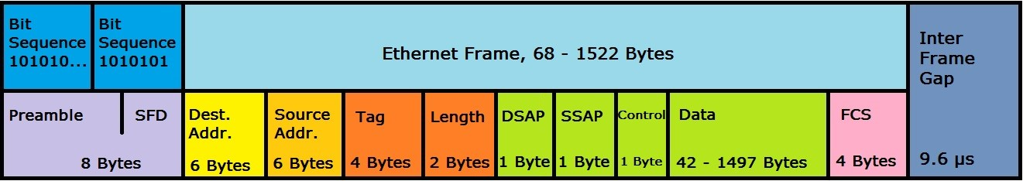

Ethernet Header / MAC address
a) It consist of two sub-layers – i) Logical Link Control (LLC), ii) Media Access Control (MAC).
i) LLC – closure to network layer and tells what type protocol at above layer (ie. IP, IPX, Appletalk).
ii) MAC – closure to physical layer and has physical Address / Burnt In Address (BIA) / MAC address.

Slide 17
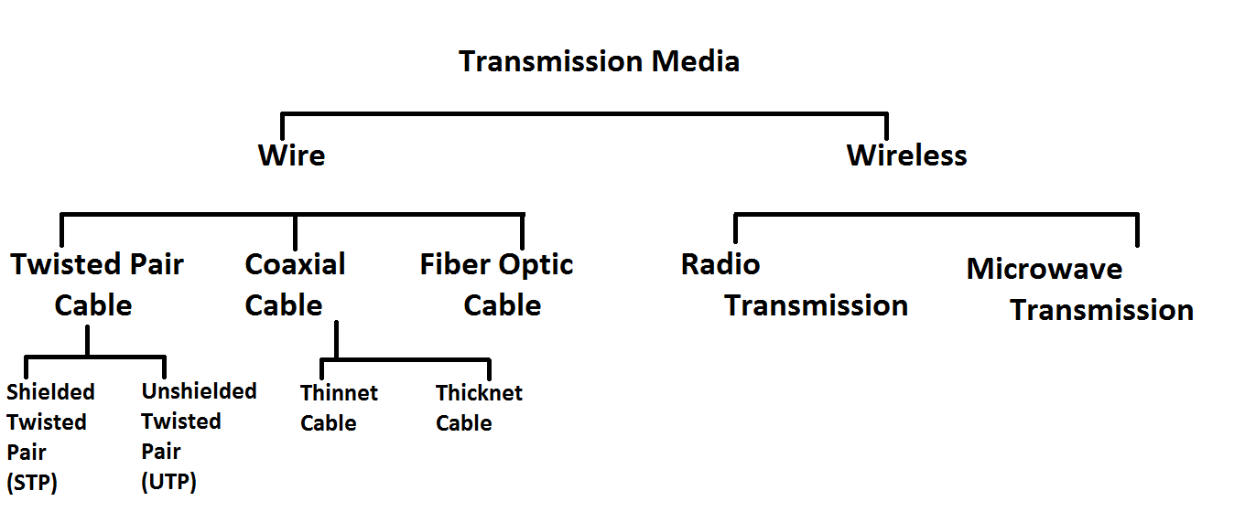
Physical Layer

Slide 18
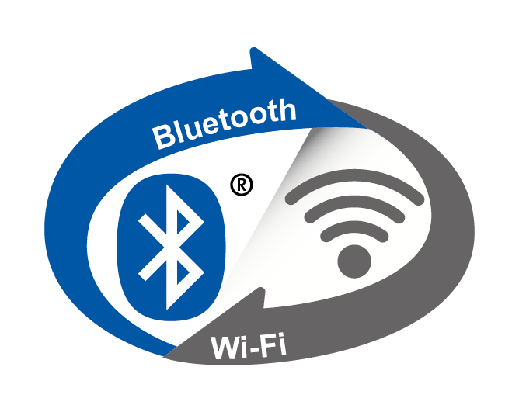
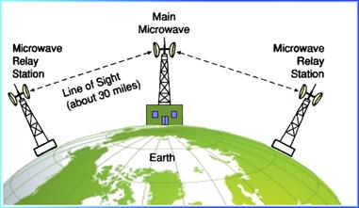
Radio Transmission
Microwave Transmission

Slide 19
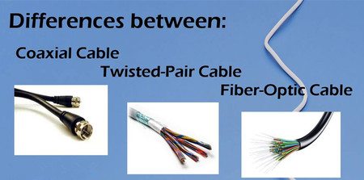
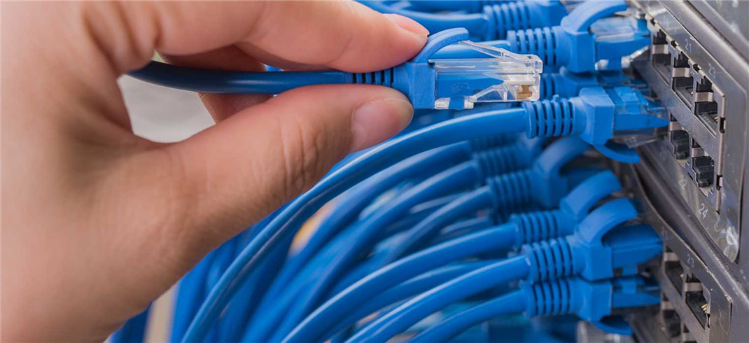

Slide 20
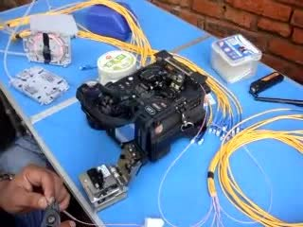
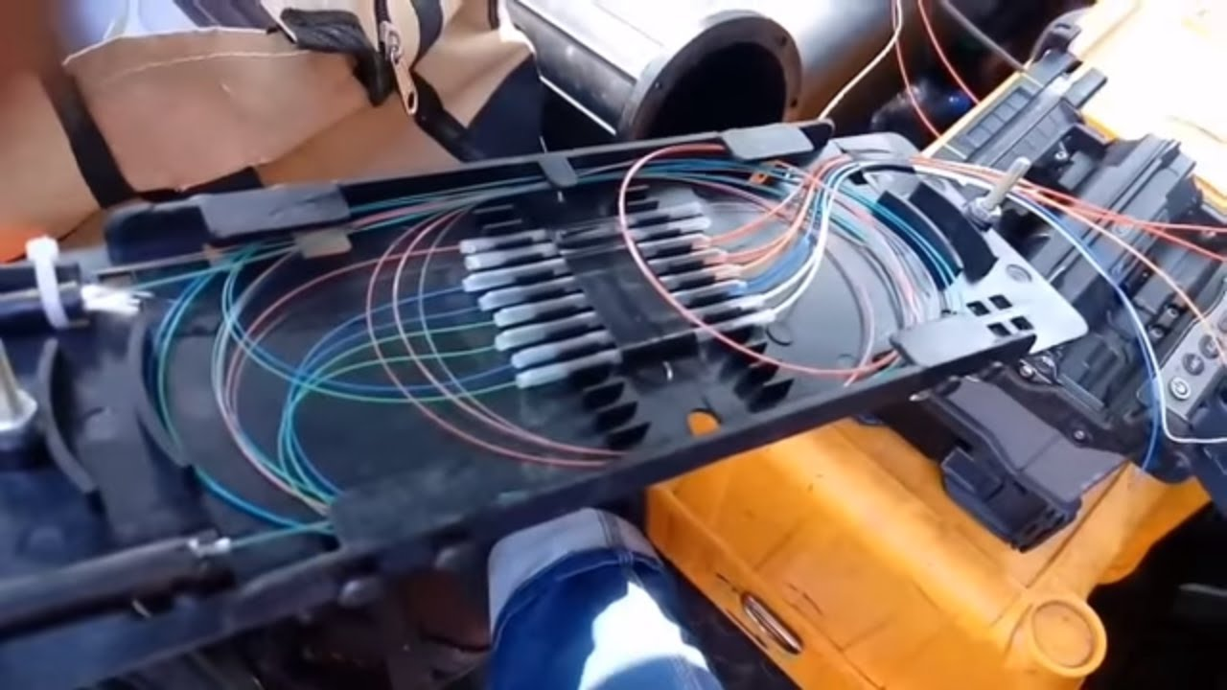
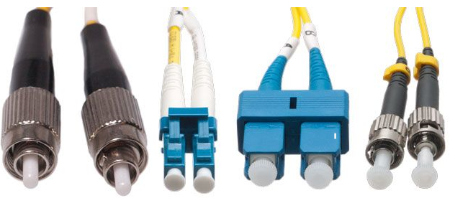
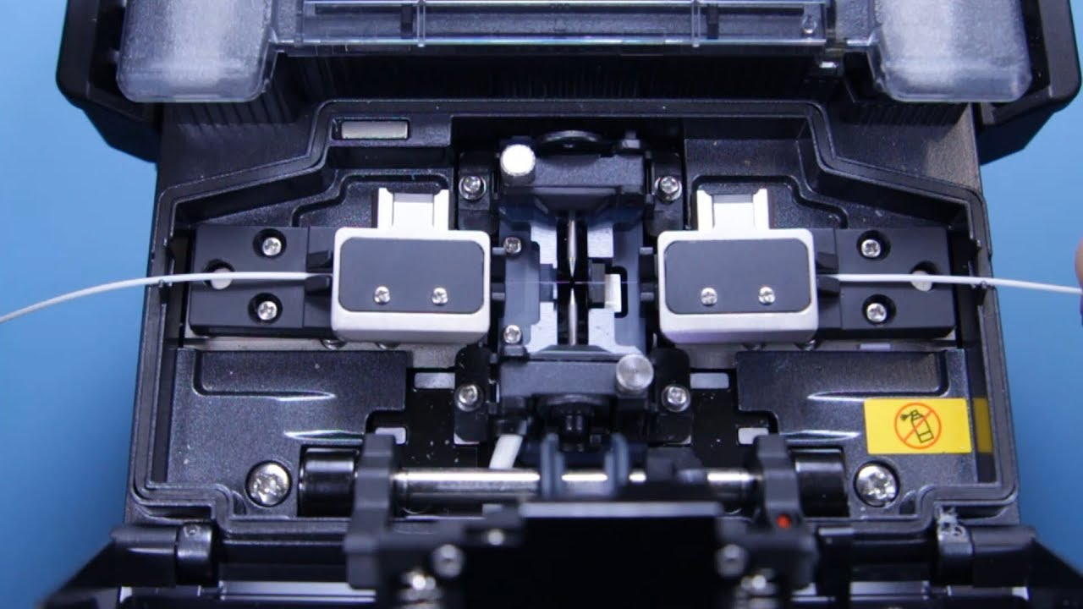

Slide 21
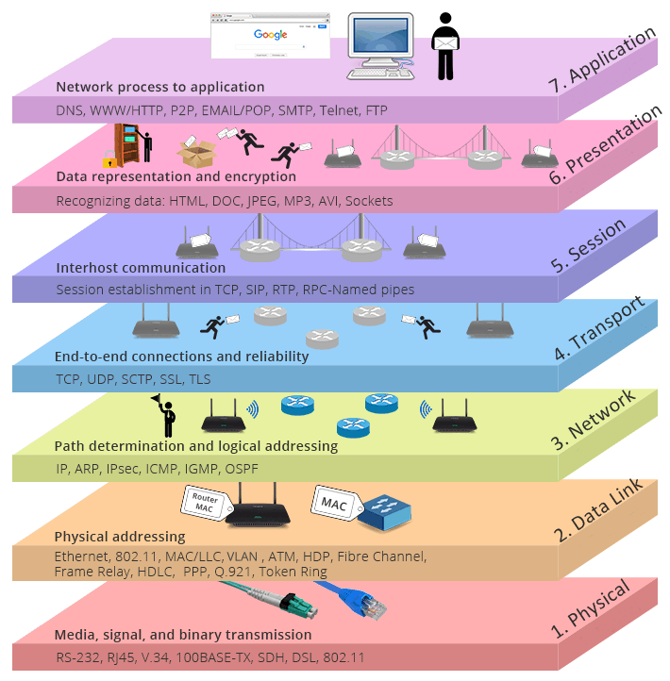


Slide 22
Key Differences Between TCP/IP and OSI Model
TCP/IP is a client-server model, i.e. when the client requests for service it is provided by the server. Whereas, OSI is a conceptual model.
TCP/IP is a standard protocol used for every network including the Internet, whereas, OSI is not a protocol but a reference model used for understanding and designing the system architecture.
TCP/IP is a four-layered model, whereas, OSI has seven layers.
TCP/IP follows Horizontal approach. On the other hand, the OSI Model supports Vertical approach.
TCP/IP is Tangible, whereas, OSI is not.
TCP/IP follows top to bottom approach, whereas, OSI Model follows a bottom-up approach.

